Slide 1
LING 138/238 SYMBSYS 138
Intro to Computer Speech and Language Processing
Lecture 5: Part of Speech Tagging (I):
October 7, 2004
Dan Jurafsky
Thanks to Jim Martin, Dekang Lin, and Bonnie Dorr for some of the examples and details in these slides!

Slide 2
Week 3: Part of Speech tagging
Part of speech tagging
  Parts of speech
  What’s POS tagging good for anyhow?
  Tag sets
  Rule-based tagging
  Statistical tagging
  “TBL” tagging

Slide 3
Parts of Speech
8 traditional parts of speech
  Noun, verb, adjective, preposition, adverb, article, interjection, pronoun, conjunction, etc
  This idea has been around for over 2000 years (Dionysius Thrax of Alexandria, c. 100 B.C.)
  Called: parts-of-speech, lexical category, word classes, morphological classes, lexical tags, POS
  We’ll use POS most frequently

Slide 4
POS examples
N noun chair, bandwidth, pacing
V verb study, debate, munch
ADJ adj purple, tall, ridiculous
ADV adverb unfortunately, slowly,
P preposition of, by, to
PRO pronoun I, me, mine
DET determiner the, a, that, those

Slide 5
POS Tagging: Definition
The process of assigning a part-of-speech or lexical class marker to each word in a corpus:
WORDS
TAGS
the
koala
put
the
keys
on
the
table
N
V
P
DET

Slide 6
POS Tagging example
WORD tag
the DET
koala N
put V
the DET
keys N
on P
the DET
table N

Slide 7
What is POS tagging good for?
Speech synthesis:
  How to pronounce “lead”?
  INsult inSULT
  OBject obJECT
  OVERflow overFLOW
  DIScount disCOUNT
  CONtent conTENT
Stemming for information retrieval
  Knowing a word is a N tells you it gets plurals
  Can search for “aardvarks” get “aardvark”
Parsing and speech recognition and etc
  Possessive pronouns (my, your, her) followed by nouns
  Personal pronouns (I, you, he) likely to be followed by verbs

Slide 8
Open and closed class words
Closed class: a relatively fixed membership
  Prepositions: of, in, by, …
  Auxiliaries: may, can, will had, been, …
  Pronouns: I, you, she, mine, his, them, …
  Usually function words (short common words which play a role in grammar)
Open class: new ones can be created all the time
  English has 4: Nouns, Verbs, Adjectives, Adverbs
  Many languages have all 4, but not all!
  In Lakhota and possibly Chinese, what English treats as adjectives act more like verbs.

Slide 9
Open class words
Nouns
  Proper nouns (Stanford University, Boulder, Neal Snider, Margaret Jacks Hall). English capitalizes these.
  Common nouns (the rest). German capitalizes these.
  Count nouns and mass nouns
    Count: have plurals, get counted: goat/goats, one goat, two goats
    Mass: don’t get counted (snow, salt, communism) (*two snows)
Adverbs: tend to modify things
  Unfortunately, John walked home extremely slowly yesterday
  Directional/locative adverbs (here,home, downhill)
  Degree adverbs (extremely, very, somewhat)
  Manner adverbs (slowly, slinkily, delicately)
Verbs:
  In English, have morphological affixes (eat/eats/eaten)

Slide 10
Closed Class Words
Examples:
  prepositions: on, under, over, …
  particles: up, down, on, off, …
  determiners: a, an, the, …
  pronouns: she, who, I, ..
  conjunctions: and, but, or, …
  auxiliary verbs: can, may should, …
  numerals: one, two, three, third, …

Slide 11
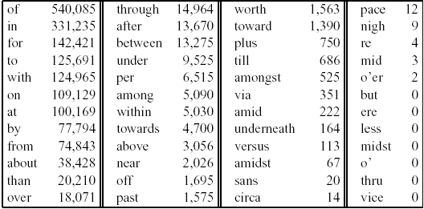
Prepositions from CELEX

Slide 12
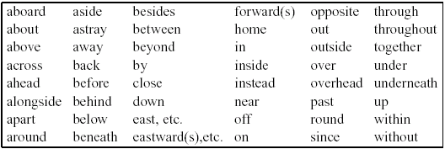
English particles

Slide 13
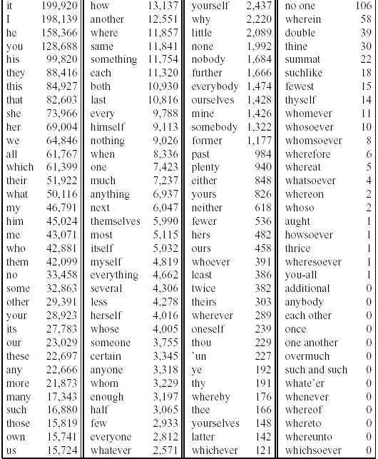
Pronouns: CELEX

Slide 14
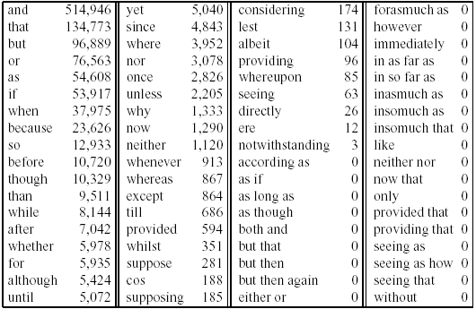
Conjunctions

Slide 15
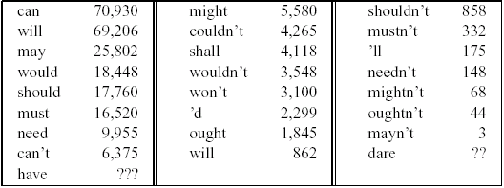
Conjunctions

Slide 16
POS tagging: Choosing a tagset
There are so many parts of speech, potential distinctions we can draw
To do POS tagging, need to choose a standard set of tags to work with
Could pick very coarse tagets
  N, V, Adj, Adv.
More commonly used set is finer grained, the “UPenn TreeBank tagset”, 45 tags
  PRP$, WRB, WP$, VBG
Even more fine-grained tagsets exist

Slide 17
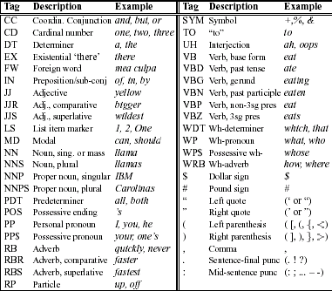
PRP
PRP$

Slide 18
Using the UPenn tagset
The/DT grand/JJ jury/NN commmented/VBD on/IN a/DT number/NN of/IN other/JJ topics/NNS ./.
Prepositions and subordinating conjunctions marked IN (“although/IN I/PRP..”)
Except the preposition/complementizer “to” is just marked “to”.

Slide 19
POS Tagging
Words often have more than one POS: back
  The back door = JJ
  On my back = NN
  Win the voters back = RB
  Promised to back the bill = VB
The POS tagging problem is to determine the POS tag for a particular instance of a word.
These examples from Dekang Lin

Slide 20
How hard is POS tagging? Measuring ambiguity
Unambiguous (1 tag): 35,340
Ambiguous (2-7 tags): 4,100
2 tags | 3,760
3 tags | 264
4 tags | 61
5 tags | 12
6 tags | 2
7 tags | 1
(Derose, 1988)

Slide 21
3 methods for POS tagging
Rule-based tagging
  (ENGTWOL)
Stochastic (=Probabilistic) tagging
  HMM (Hidden Markov Model) tagging
Transformation-based tagging
  Brill tagger

Slide 22
Rule-based tagging
Start with a dictionary
Assign all possible tags to words from the dictionary
Write rules by hand to selectively remove tags
Leaving the correct tag for each word.

Slide 23
Start with a dictionary
she: PRP
promised: VBN,VBD
to TO
back: VB, JJ, RB, NN
the: DT
bill: NN, VB
Etc… for the ~100,000 words of English

Slide 24
Use the dictionary to assign every possible tag
NN
RB
VBN JJ VB
PRP VBD TO VB DT NN
She promised to back the bill

Slide 25
Write rules to eliminate tags
Eliminate VBN if VBD is an option when VBN|VBD follows “<start> PRP”
NN
RB
JJ VB
PRP VBD TO VB DT NN
She promised to back the bill
VBN

Slide 26
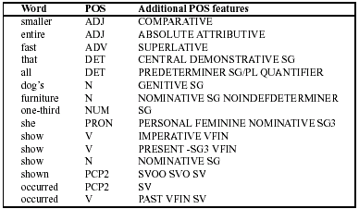
Sample ENGTWOL Lexicon

Slide 27
Stage 1 of ENGTWOL Tagging
First Stage: Run words through FST morphological analyzer to get all parts of speech.
Example: Pavlov had shown that salivation …
Pavlov PAVLOV N NOM SG PROPER
had HAVE V PAST VFIN SVO
HAVE PCP2 SVO
shown SHOW PCP2 SVOO SVO SV
that ADV
PRON DEM SG
DET CENTRAL DEM SG
CS
salivation N NOM SG

Slide 28
Stage 2 of ENGTWOL Tagging
Second Stage: Apply constraints.
Constraints used in negative way.
Example: Adverbial “that” rule
Given input: “that”
If
(+1 A/ADV/QUANT)
(+2 SENT-LIM)
(NOT -1 SVOC/A)
Then eliminate non-ADV tags
Else eliminate ADV

Slide 29
Statistical Tagging
Based on probability theory
Today we’ll introduce a few basic ideas of probability theory
But mainly we’ll introduce the simple “most-frequent-tag” algorithm

